Slide 1

50Hertz
Time Series Analyzes

Slide 2

Intro
CONTRIBUTING FACTORS
Temperature
Lightness
Economic conditions
Holidays

Slide 3
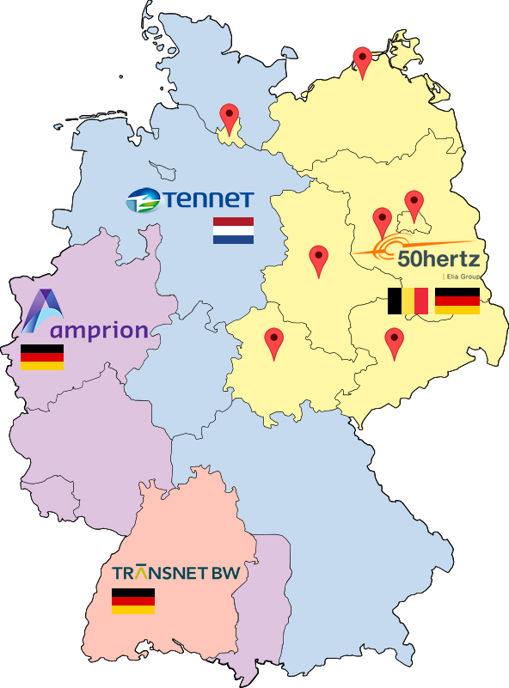
Intro
MAIN CONSUMERS
Berlin
Brandenburg
Hamburg
Mecklenburg-Western
Pomerania
Saxony
Saxony-Anhalt
Thuringia

Slide 4
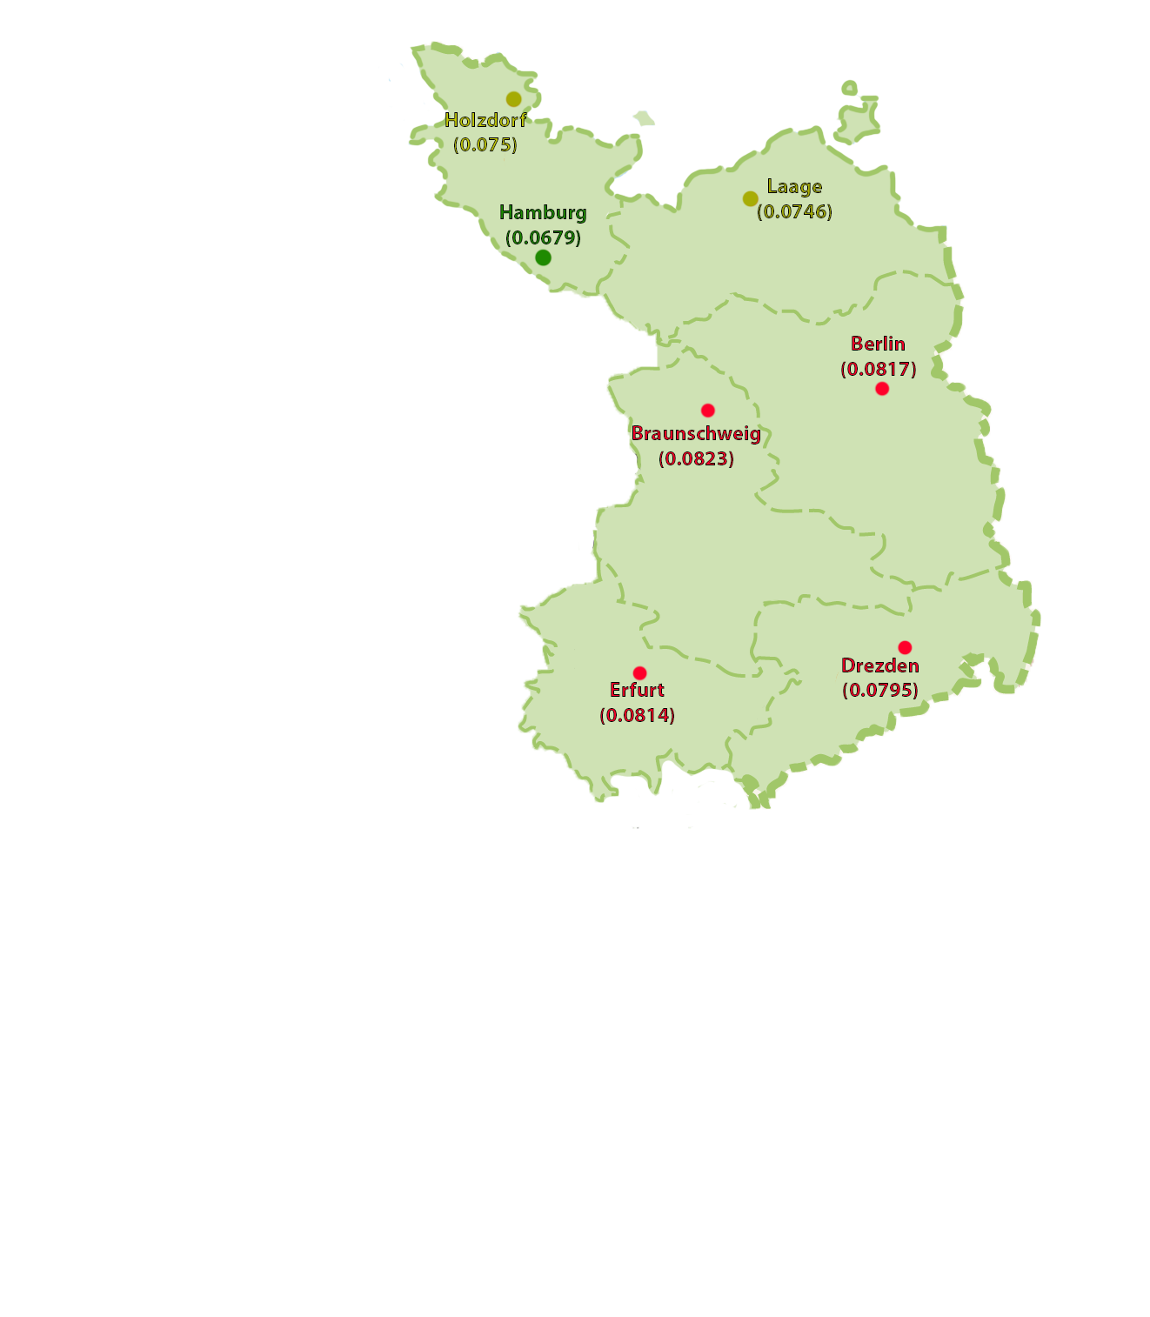
Data Preparation
Choosing appropriate weather station

Slide 5
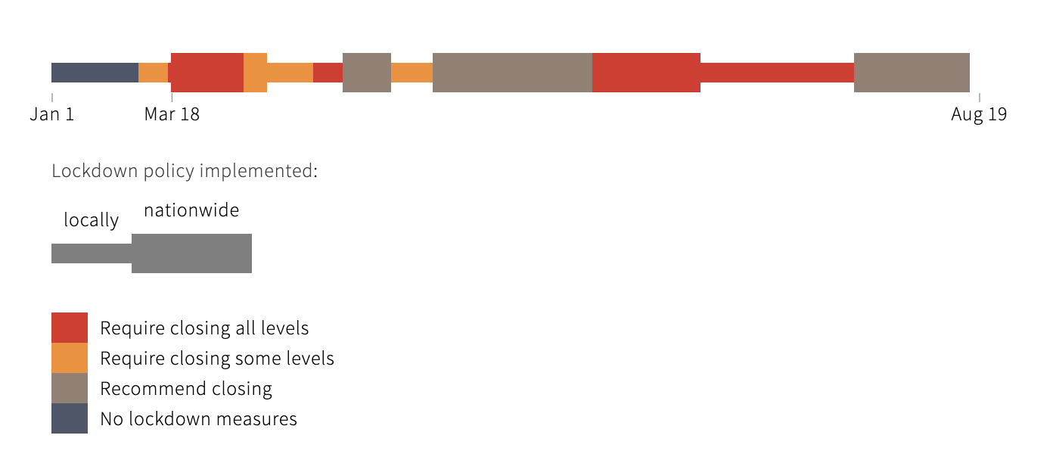
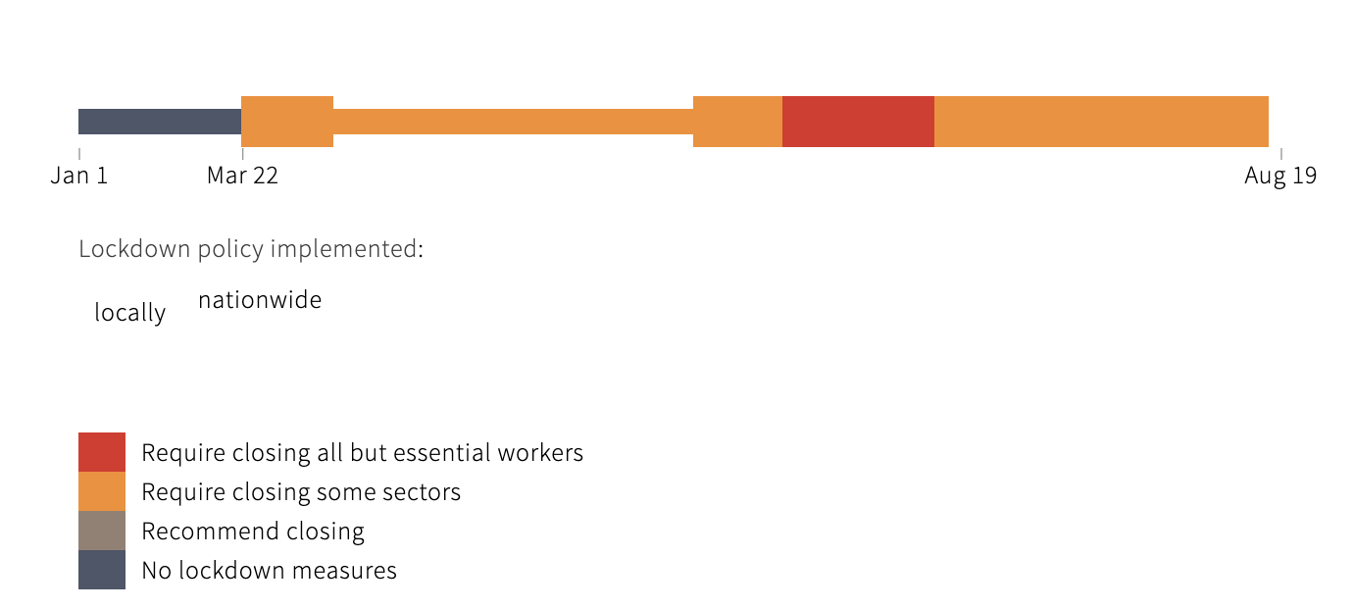
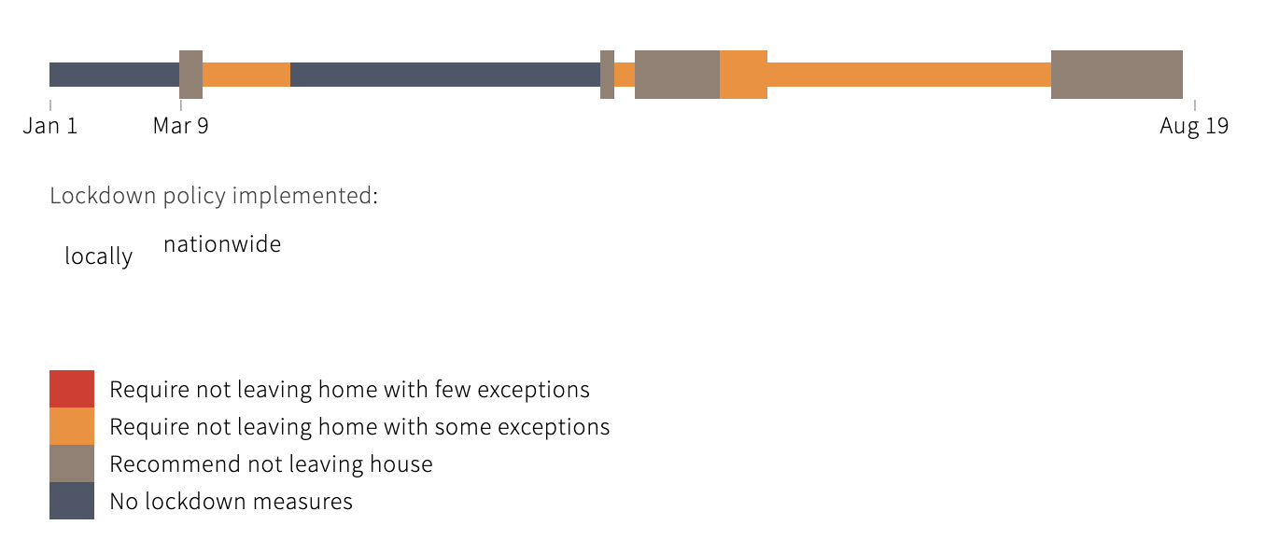
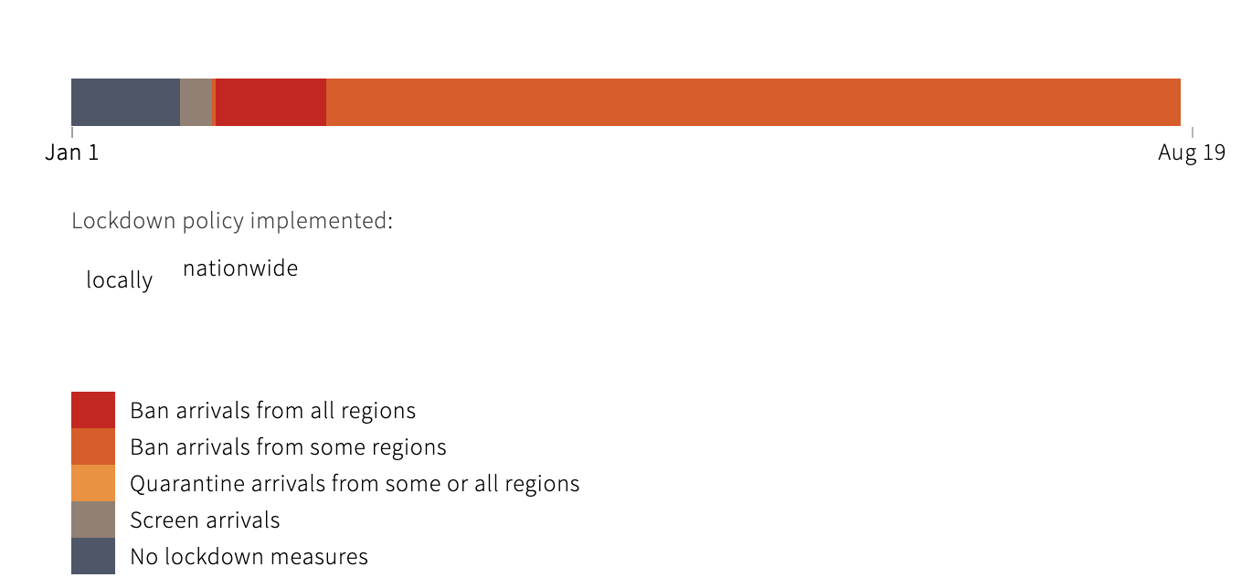
Data Preparation
Collecting lockdown data

Slide 6
Data Preparation
WEATHER FEATURES
Air temperature
Atmospheric preassure
Relative humidity
Wind speed
Total cloud cover
Horizontal visibility

Slide 7
Models
H20, (gbm)
MSE | RMSE | MAE | MAPE | CP | KGE
0.8629962 | 0.9289759 | 0.6552174 | 0.05865886 | -2.150412 | 0.3481592

Slide 8
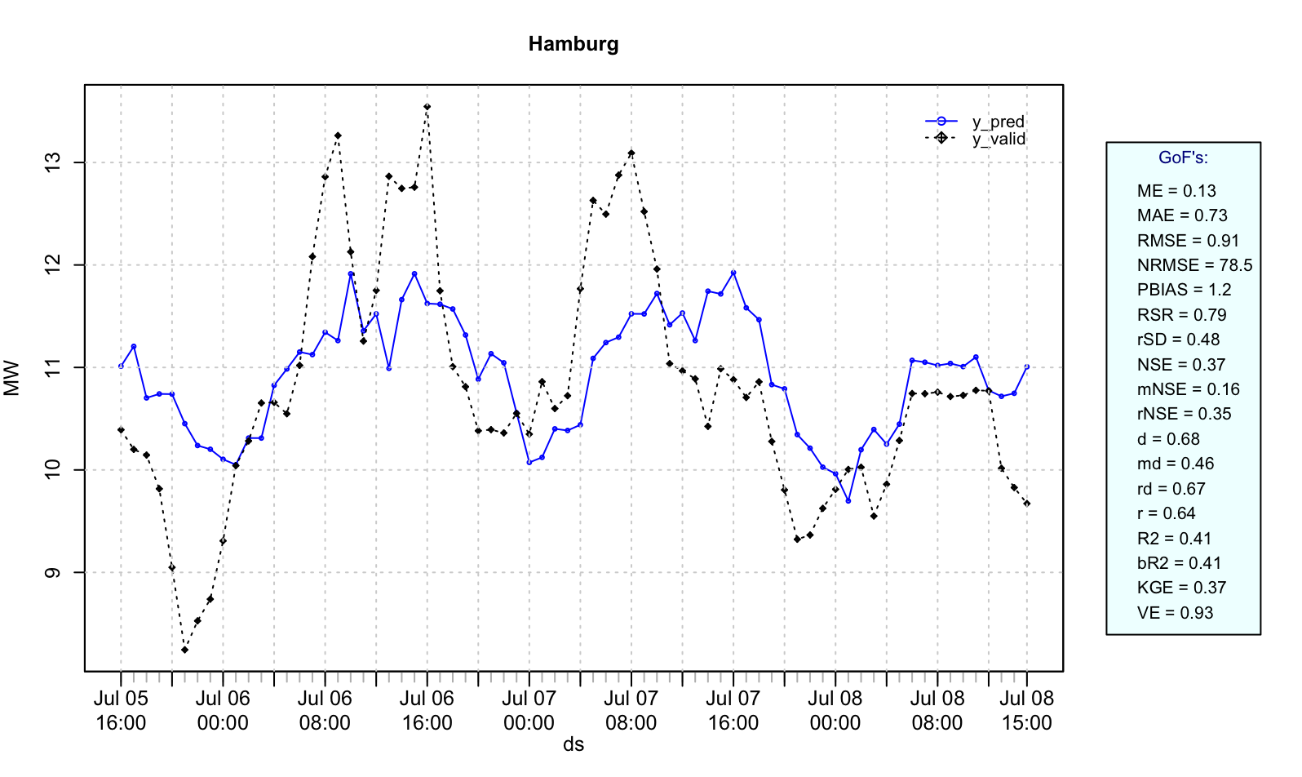
Models
Prophet
MSE | RMSE | MAE | MAPE | CP | KGE
0.8354067 | 0.9140059 | 0.7296678 | 0.06794679 | -2.030819 | 0.3694624

Slide 9
Models
Prophet

